Slide 1
MSR XGK EX
”If you can fight and survive in the extremes of the Arctic, you can fight anywhere in the world”
Notes:
Notes:
This entire brief is unclassified.

Slide 2
Aims
The soldiers will be able to fire up and extinguish the primus according to the established procedure
The soldiers will know what fuel that is used, and the safety regulations that is to be followed with use of MSR XGK EX
The individual will independent be able to conduct simple troubleshooting
Notes:
Notes:

Slide 3
Contents
Material knowledge
Safety regulations
Preparations before use
Fire up and use
troubleshooting
Maintenance
Notes:
Notes:

Slide 4
Why lesson in cooking and heat source?
The purpose with this lesson in cooking and heat source is to give the soldier the knowledge that is needed to use, treat, troubleshooting and maintain the heat source on a safe and effective way.
Notes:
Notes:

Slide 5
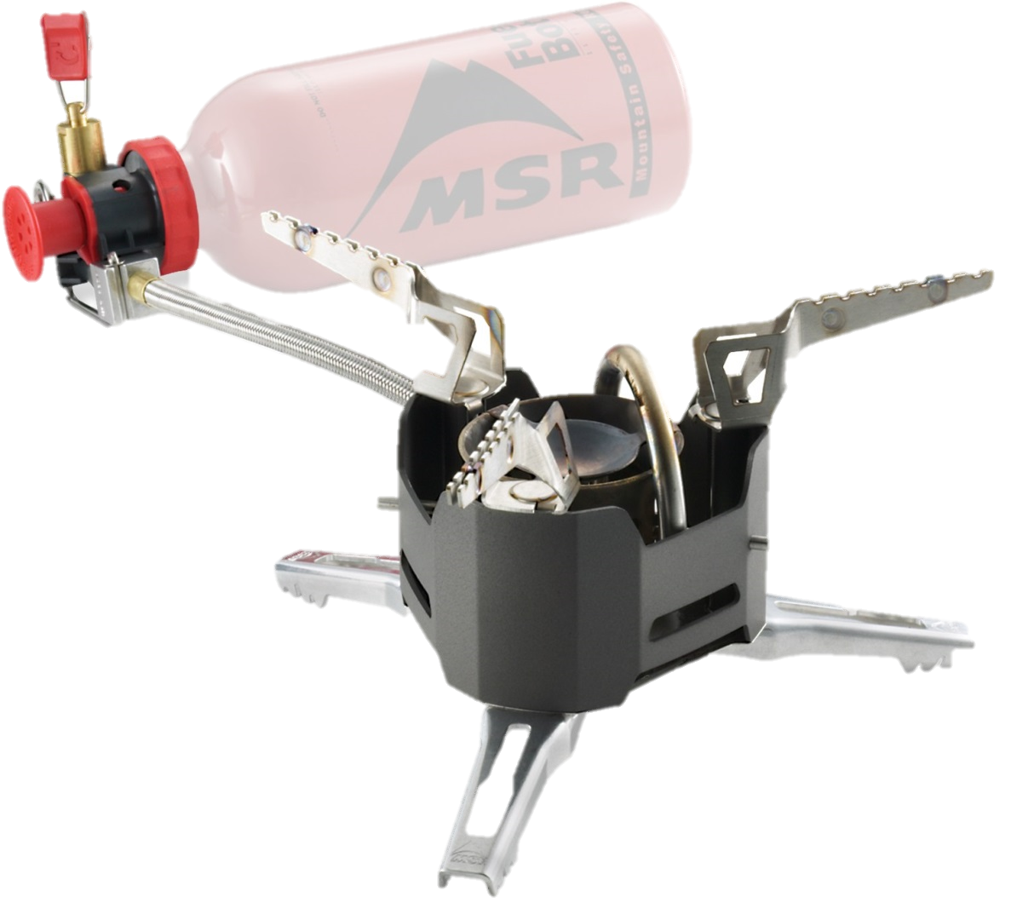
Material knowledge
Technical data
Complete set 2 kg w/o – fuel
0,7 kg burner w/accessories
0,4 kg bottle, fuel
0,9 kg boiler sets
Estimated 2 hours burn time per bottle
Effect 2000 Watt
Components
Burner with cover and underlay
Pump x 2
Reserve rate
Boiler set
Bottle, fuel with funnel
Notes:
Notes:

Slide 6
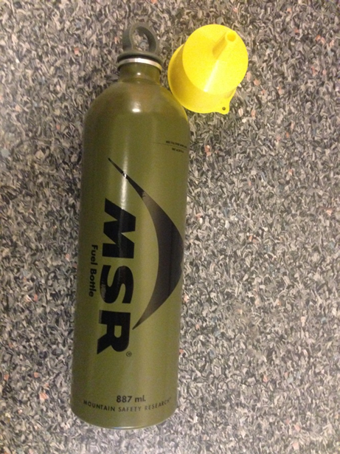
Fuel
Preheating fluid
Diesel
Cleaned gasoline
Main fuel
Diesel (F-34)
Pre heating with methylated spirit demanding own bottle and the risk of spilling increased
Cleaned gasoline (F-67)
Pre heating with main fuel Open fuel valve
Notes:
Notes:

Slide 7
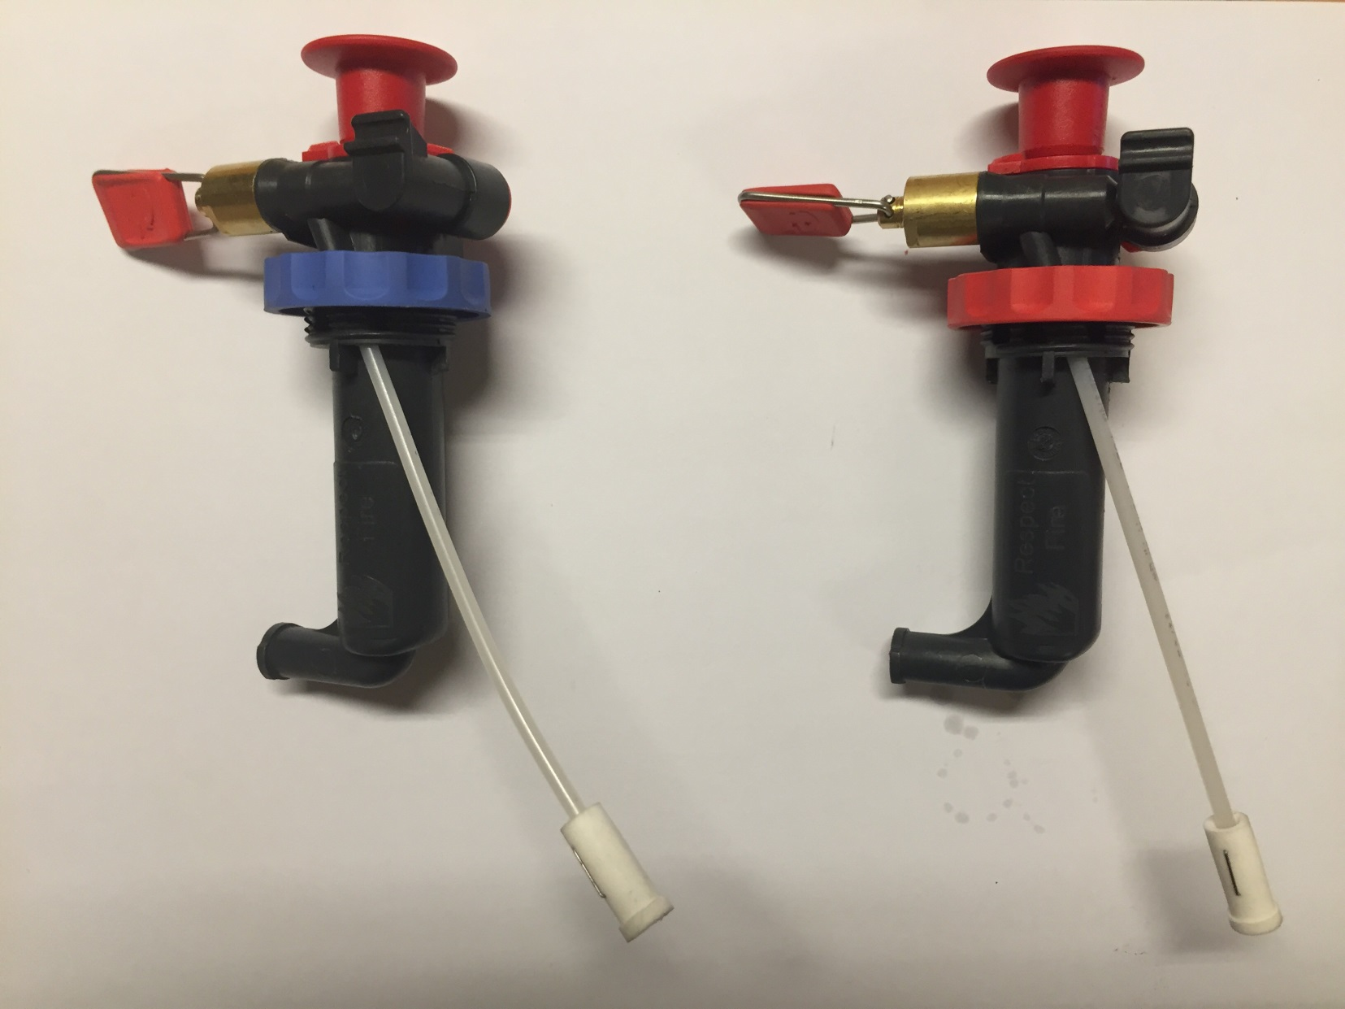
Pump
Application pump:
Red= -20$°$C and warmer
Blue= 0$°$C and colder
Notes:
Notes:
Use of pumps:
red= -20$°$C and warmer.
Blue= 0$°$C and colder.
This basically means we use the red pump almost the whole year.

Slide 8
UD 2-1
Fire guard
Combustion blue vs. yellow
Use off kettle/pan
Knife available
Carbon monoxide
Colourless and odourless
Danger with incomplete combustion
Symptoms:
Easy headache, nausea, increased headache, laxity, unconsciousness or conspicuously red skin-color
Prevented with good ventilation
Notes:
Notes:

Slide 9
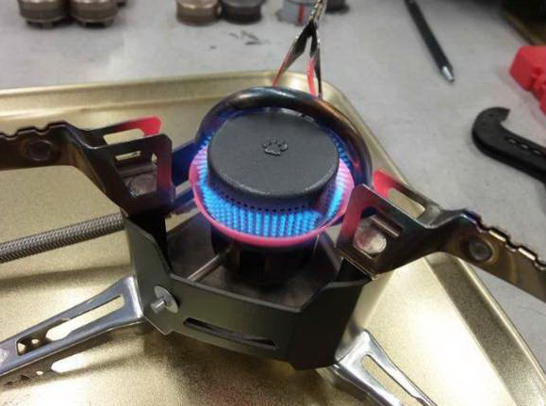
Fire up
All liquids that is used is flammable and will ignite in contact with open flame – avoid spills
Work under controlled conditions
Correct nozzle to the fuel type
Be alerted on fuel damp when you open the vents
Notes:
Notes:

Slide 10
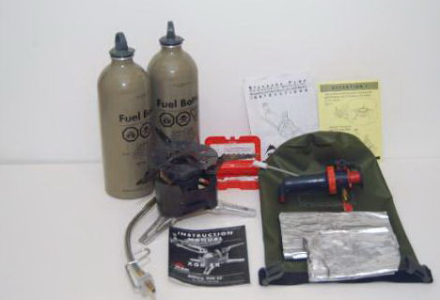
Provisioning for usage and fire up
Control before use:
All components present under the control
Check list:
Fuel
Pump
Fuel bottle
Burner with fuel hose
Nozzle
Kettle sets 5 pieces
Spare parts
Compositing and functional test
Notes:
Notes:

Slide 11
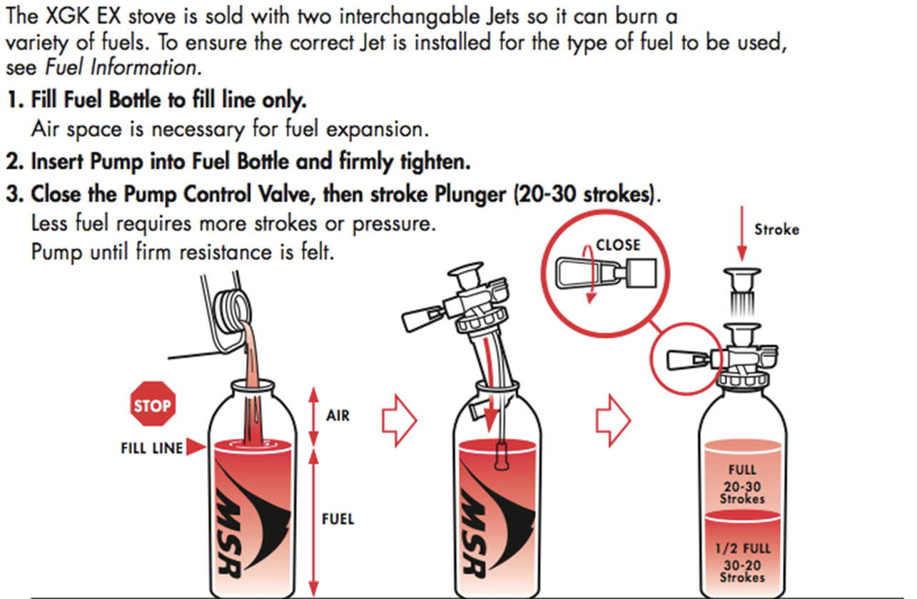
Assembly
Notes:
Notes:
Do not fill over the label shown on slide 1 over.
Inject the pump as shown on picture 2.
Make sure the valve is CLOSED – after that pump up the pressure (20-30 strokes).

Slide 12
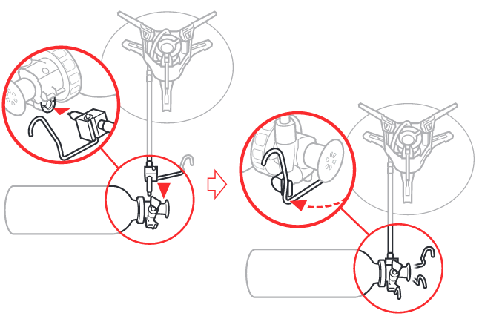
Assembly
Notes:
Notes:
Insert the attachment point from the burner to the MSR bottle. Attach the pin with the hoop as shown as picture 3.

Slide 13
Preheating - Start-up
Notes:
Notes:
The slide show that you open the control valve with one rotation. Most likely nothing will happen, good practice is that you open the control valve carefully until fuel coming out. When fuel comes out, close it immediately. (approx. 3 sec with fuel).

Slide 14
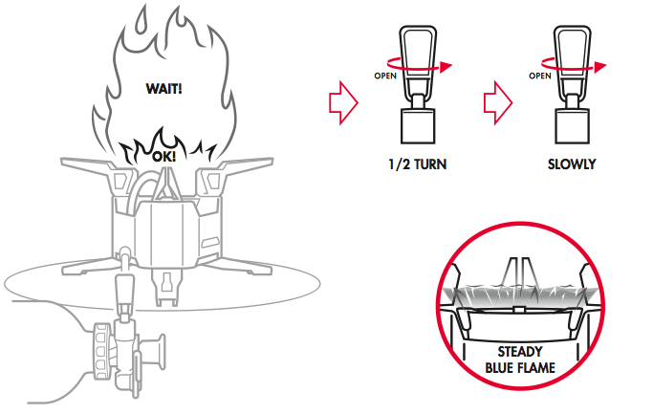
Preheating - Start-up
Notes:
Notes:
Open control valve careful before the pre heating is done. (half rotation is too little), if the burner don't burn with a stable clear blue flame let the burner burn with a weak blue flame that will help the pre heating process.
If the flame is yellow, close the burner and start preheating again.

Slide 15
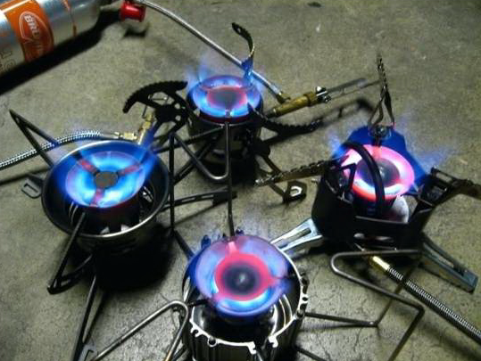
Supervision under usage
Make sure there are no flammable materials near the heat source
Maintain the pressure on fuel bottle through pumping
Look after leaks
Observe if the heat source is burning with a blue flame all the way around the whole circumference of the flame-spreader
Fill up fuel bottles (mainly outside the tent).
Make sure for good air supply in the tent. If there are used kettles on the heat source, is ventilation very important
Pressure- Maintenance- Observe- Prevention
Notes:
Notes:

Slide 16
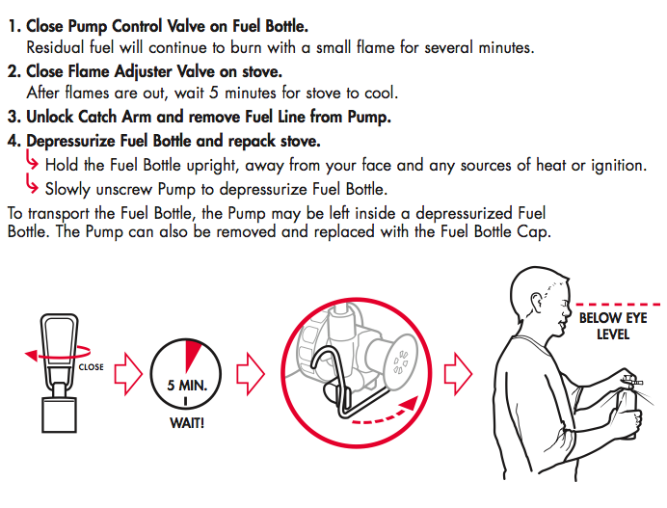
Extinction- Packing- Transportation
Notes:
Notes:
Close the pump – and let it burn out some minutes.
After the burnout – let the burner cool down for 5 minutes.
Unlock catch arm and remove fuel line from pump.
NOTE! When you remove the pump from the bottle there will be pressure on the bottle, open bits by bits, and the pressure will adjust.

Slide 17
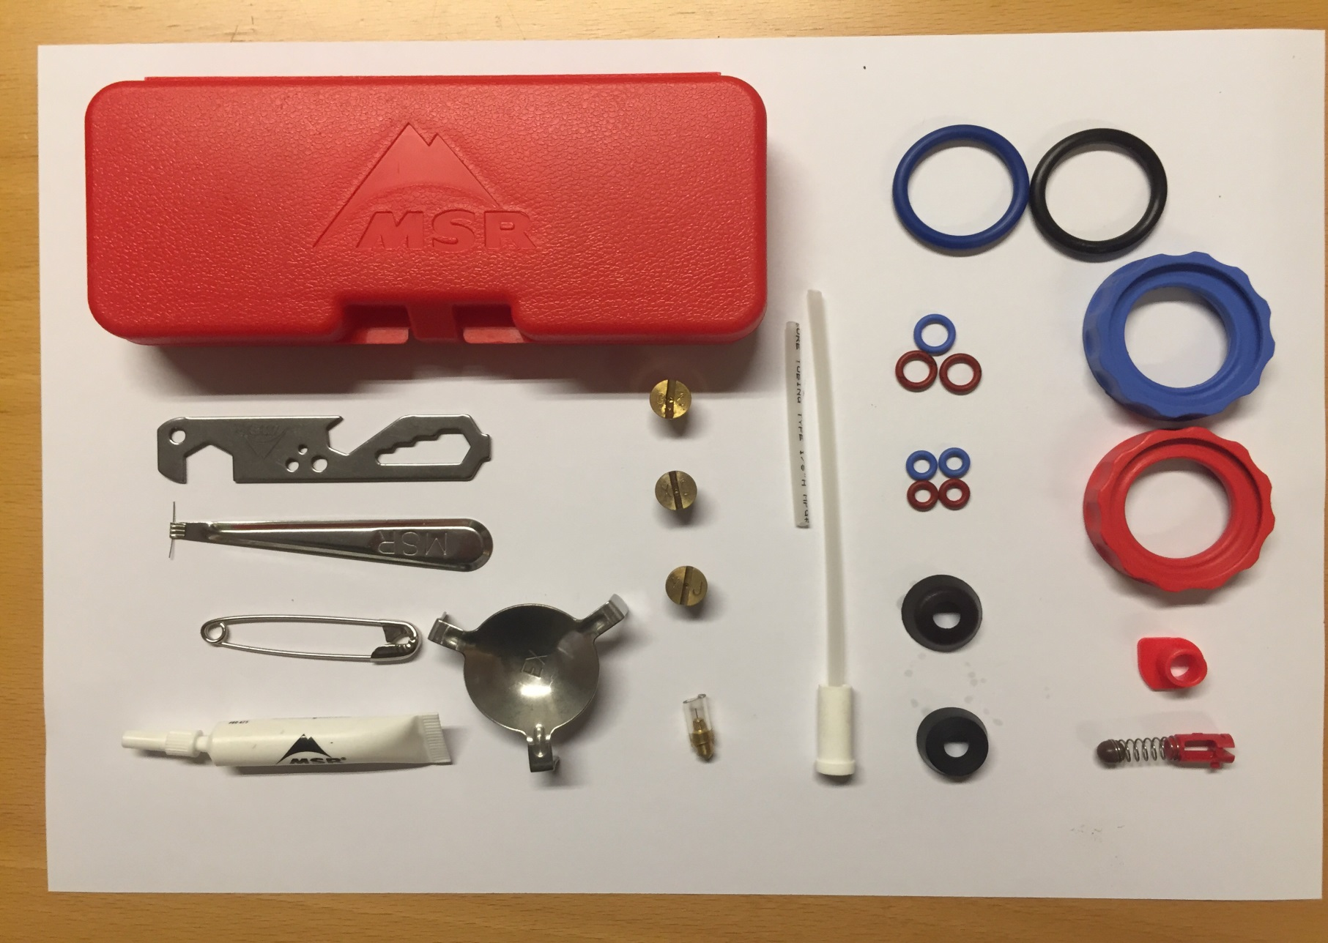
Spare parts – rep set
1
12
13
17
7
2
14
8
18
3
9
15
4
6
19
5
10
11
16
20
Notes:
Notes:
Parts – rep set:
1: Box spare parts
2: Tools
3: Cleaning tool
4: Safety needle
5: Silicon tube
6: Flame spreader
7: Nozzle GK - gasoline, paraffin
8: Nozzle XD – Diesel
9: Nozzle XJ – J8, F34
10: Cleaning needle
11: Fuel pipe with filter
12: O-ring to bottle cork
13: O-ring pump coupling
14: O-ring Control valve
15: Pump cup leather
16: Pump cup rubber
17: Gasket pump (blue)
18: Gasket pump (red)
19: Pump coupling (fuel hose)
20: Return valve

Slide 18
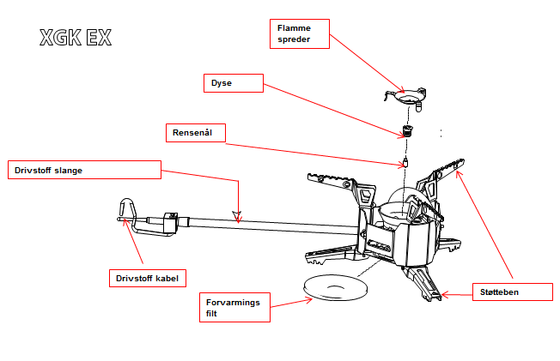
Parts - burner
Notes:
Notes:
Flame spreader, ¤ 30168521
GK Nozzle gasoline, ¤ 30168517
XJ Nozzle purified gasoline ¤ 30168516
XD Nozzle Diesel ¤ 301685
Cleaning needle ¤ 30168522
Fuel cable purification, ¤ 30168531
Preheating filter, ¤ 30168523

Slide 19
Maintenance
1 liner maintenance of:
Pump
Change/lubricate gaskets
Fuel pipe
Valve
Burner
Cleanse and rinse fuel hose
Fuel cable
Nozzle
Needle
Flame-spreader
Kettle set - washed
Notes:
Notes:

Slide 20
Troubleshooting
Fuel leak | Cause | Solution
Between pump and bottle fuel | Broken or missing gasket pump | Change gasket pump
Between pump and fuel hose | Broken or missing O-ring pump link | Change O-ring pump link
By regulation vent | Broken or missing control vent O-ring | Change O-ring regulation vent
In pump chamber | Polluted or broken valve | Clean or change valve
Bad performance | Cause | Solution
Irregular yellow flames | Insufficient pre heating | Repeat pre heating
Pump don't create pressure in the bottle fuel | Dried out or damaged pump cup | Butter or change pump cup
Reduced flame/ effect | Low pressure in bottle fuel or lack on air supply | Pump pressure in the bottle or increase air supply through opening off for example windscreen
By high pressure on bottle fuel | Polluted nozzle, fuel hose and fuel pipe | Clean nozzle, fuel hose with cable and rinse this, consider change of fuel pipe
Notes:
Notes:

Slide 21
Summary
Maintain a blue flame for optimal combustion
MSR XGK EK burns cleaner with F-67 then F-34, and this will also affect the maintenance
Make sure of good routines for pre heating and water boiling. This to optimize the effect of the burner and avoid the production of carbon monoxide. Use cover on the kettle
Easy maintenance, clean with methylated spirit and a piece of cloth after usage
Notes:
Notes:

Slide 22
Notes:
Notes:

